Slide 1




Predicting Star Rating
From Yelp Dataset
Hemeng Maggie Li,
Chudan Ivy Liu,
Jiawen Jasmine Zhu

Slide 2
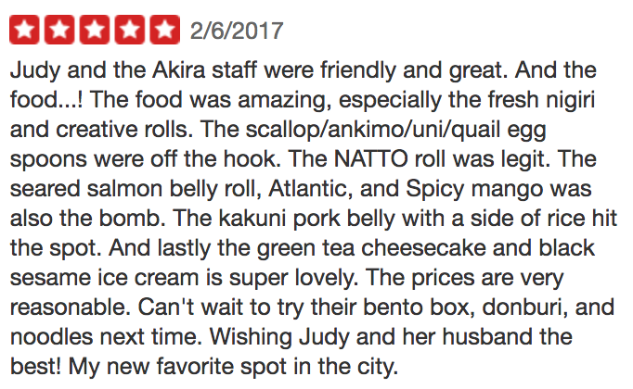

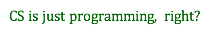


Motivation
Let’s go get food!
What about sushi?🍣🐟
Let me YELP it ! YO!
WoW, a five-star place
nearby!
Natural language processing
Predict the label !!!
Can’t wait to have the lovely salmon
belly roll 🍣🍣🍣 and black
sesame ice cream !!!!!

Slide 3




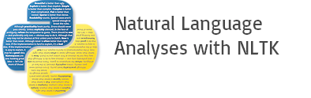


PYTHON LIBRARIES
SKLEARN
Tree
Cross validation
NUMPY
TEXTBLOB
JSON
NLTK ( opinion_lexicon )

Slide 4
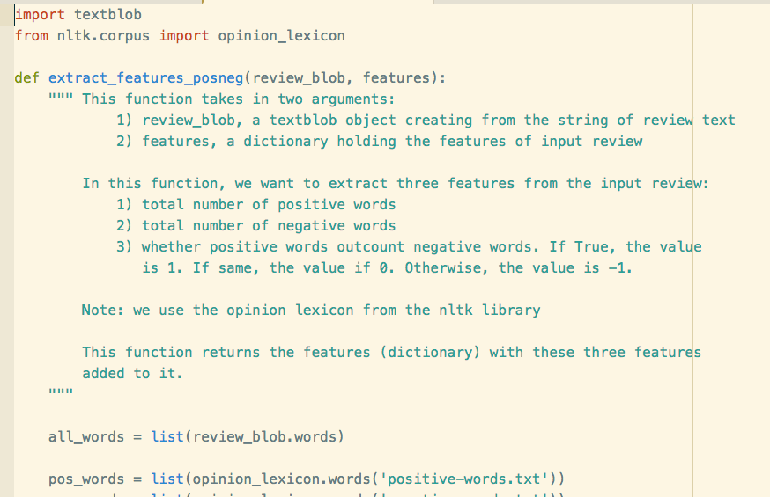
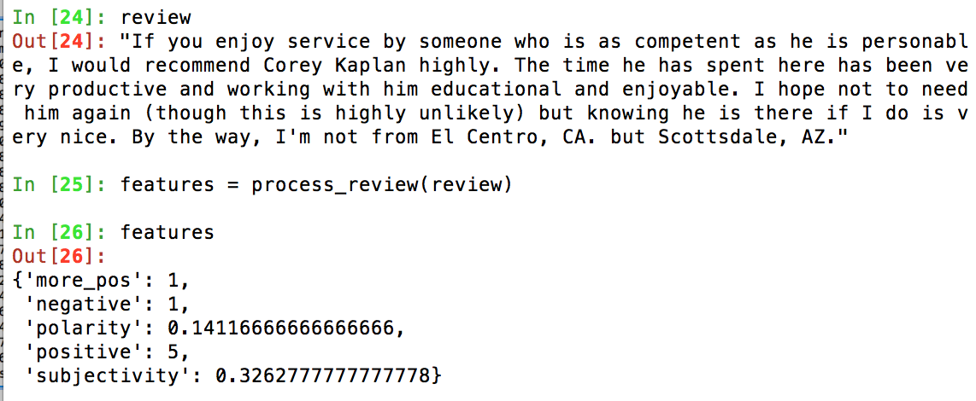
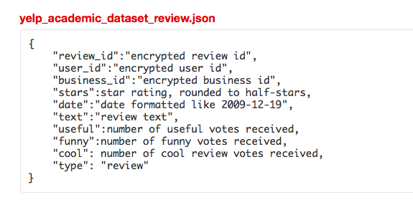
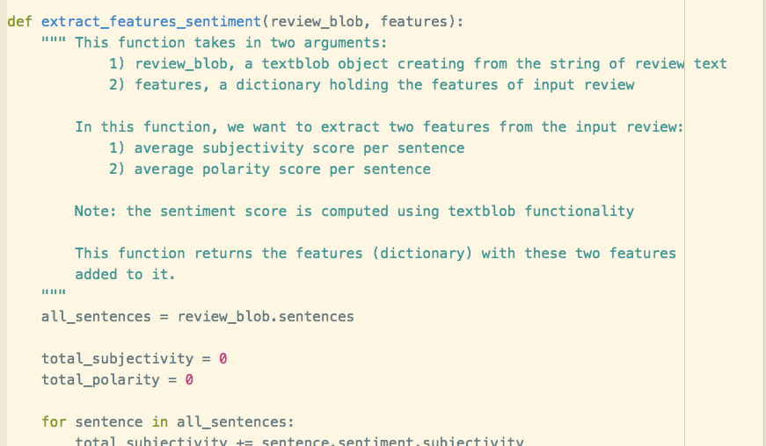
Project Progress
Extract_features.py
subjectivity score
polarity score
# positive words
# negative words
positive > negative？

Slide 5

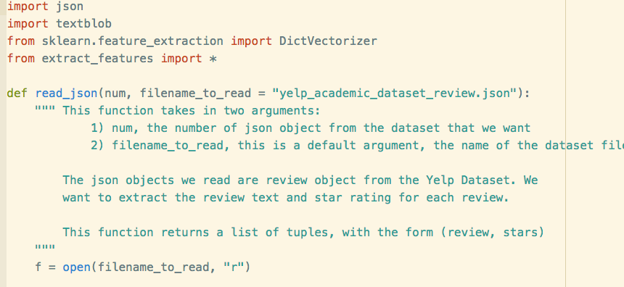
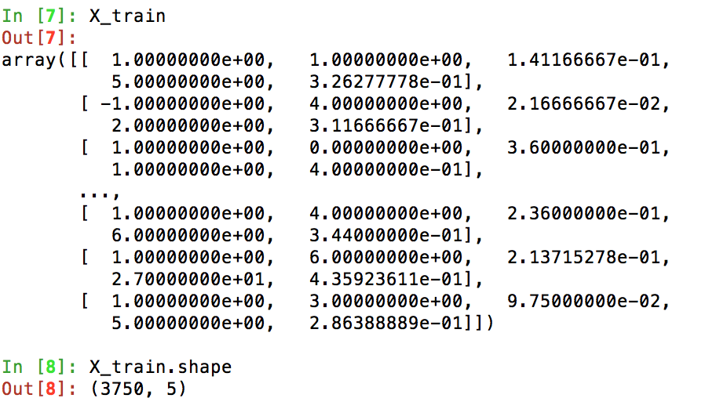
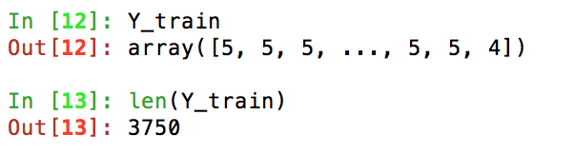
Project Progress
Data_processing..py
STAR RATINGS
FEATURES

Slide 6

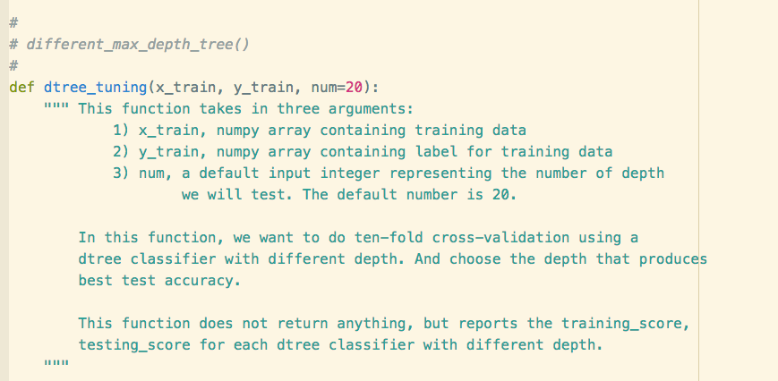
Project Progress
Training_tuning.py

Slide 7

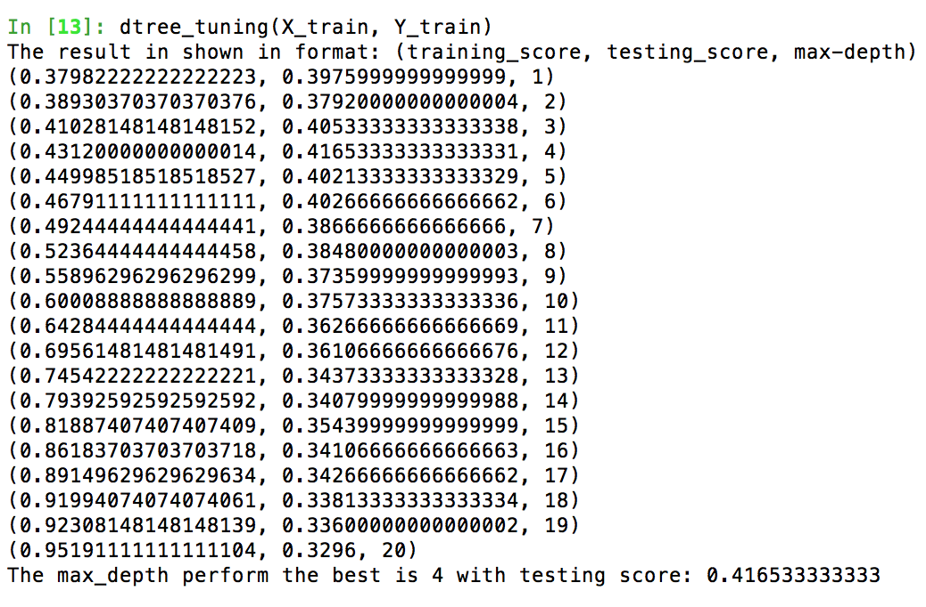
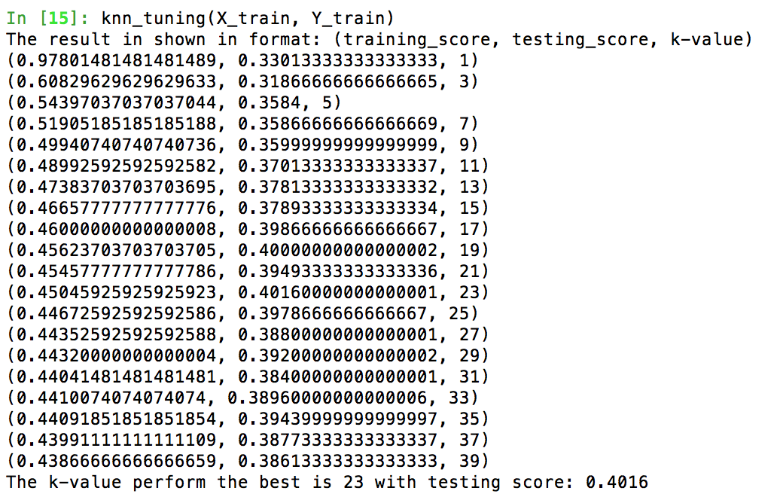
Project Progress
Training_tuning.py
2 Classifiers!
kNN
Decision Tree

Slide 8
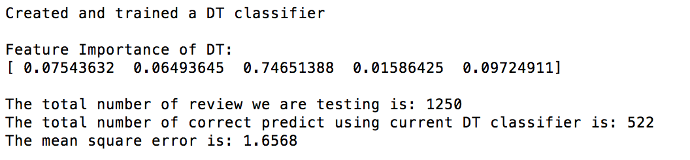
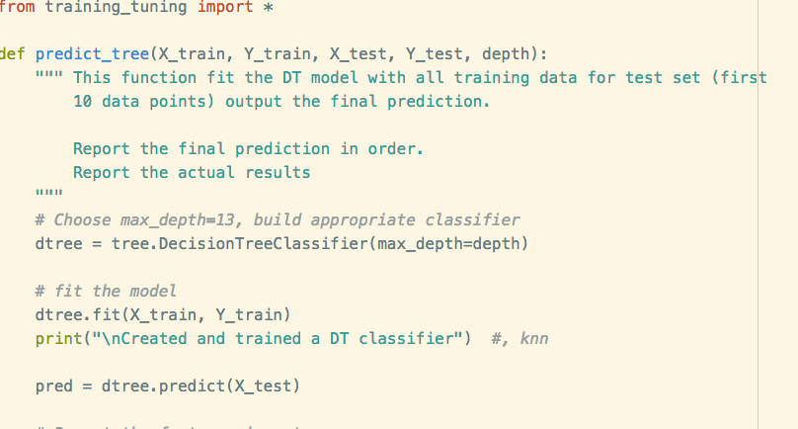
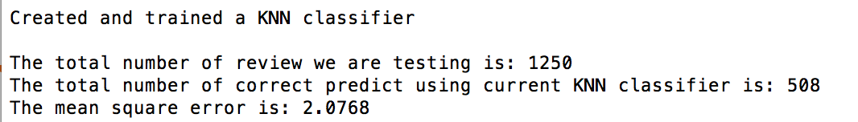
Project Progress
Prediction !
Predict.py

Slide 9
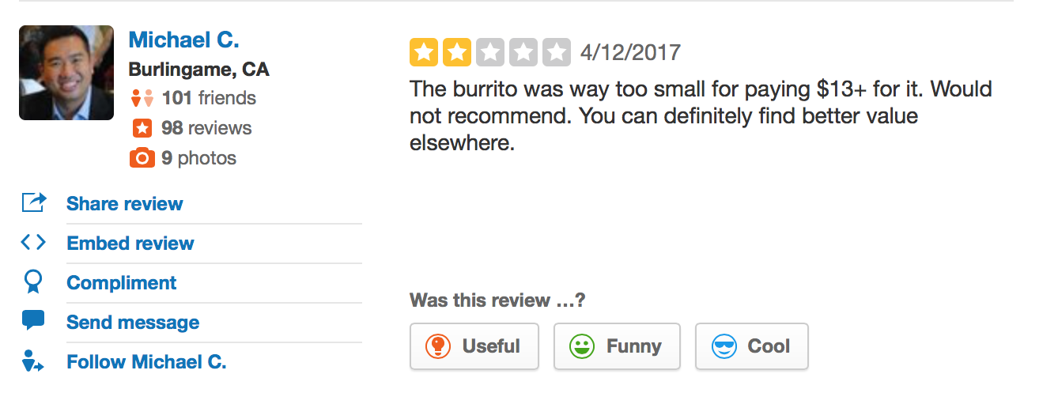
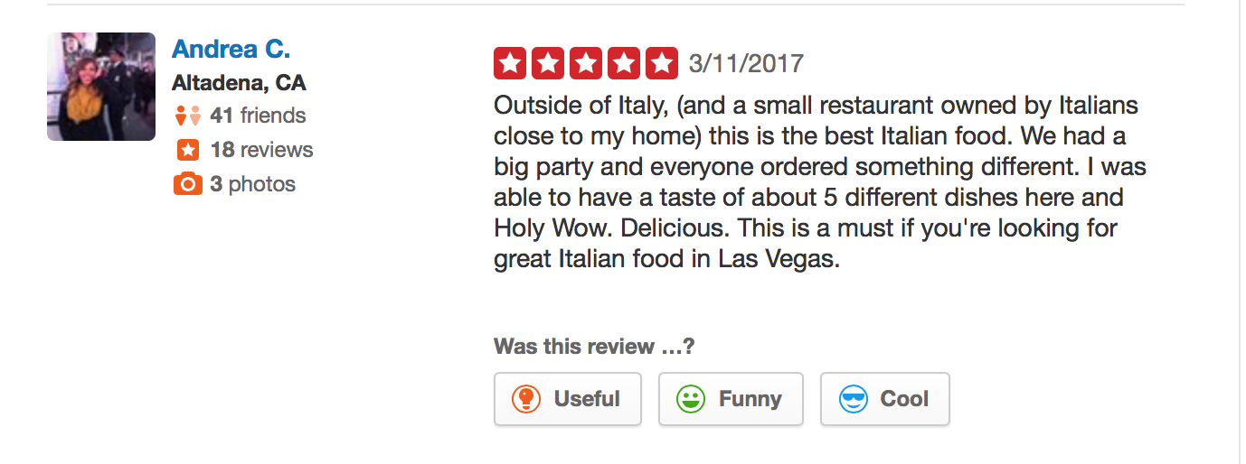
DEMO
When both classifiers work ...
BUT!

Slide 10
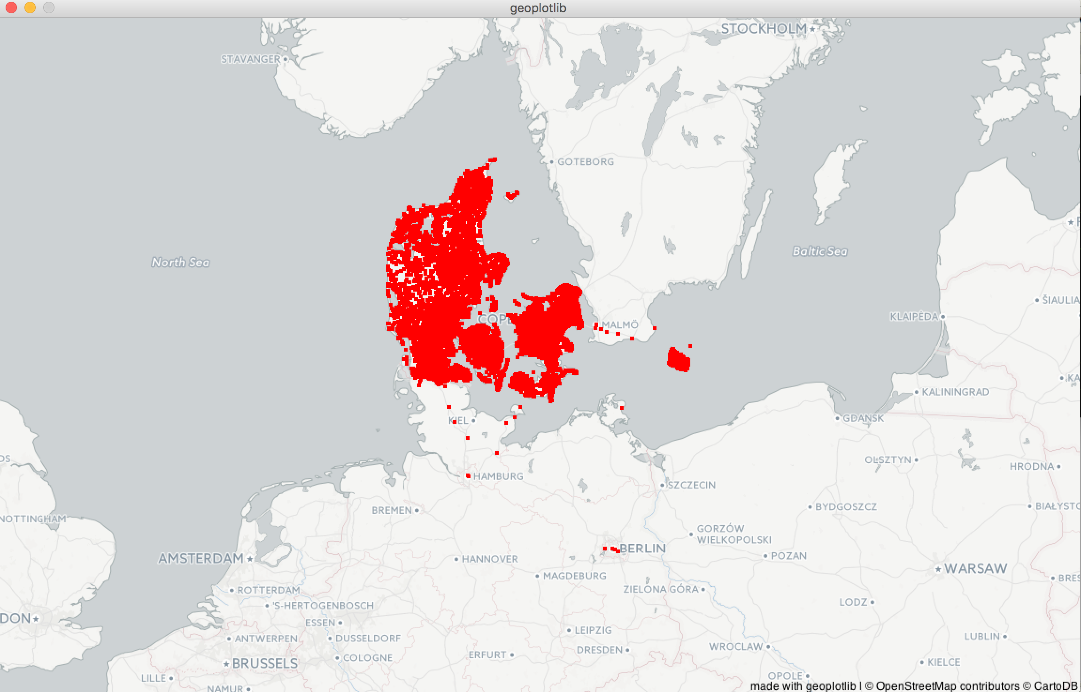
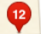
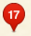
Future PlanS
?
geoplotlib: yelp in the U.S.
$$$ price range of yelp in the US
?
Yelp
+ geoplotlib
Rating in the US

Slide 11
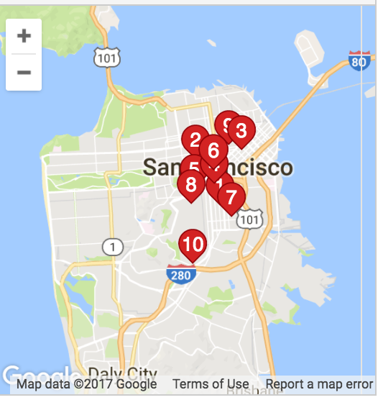

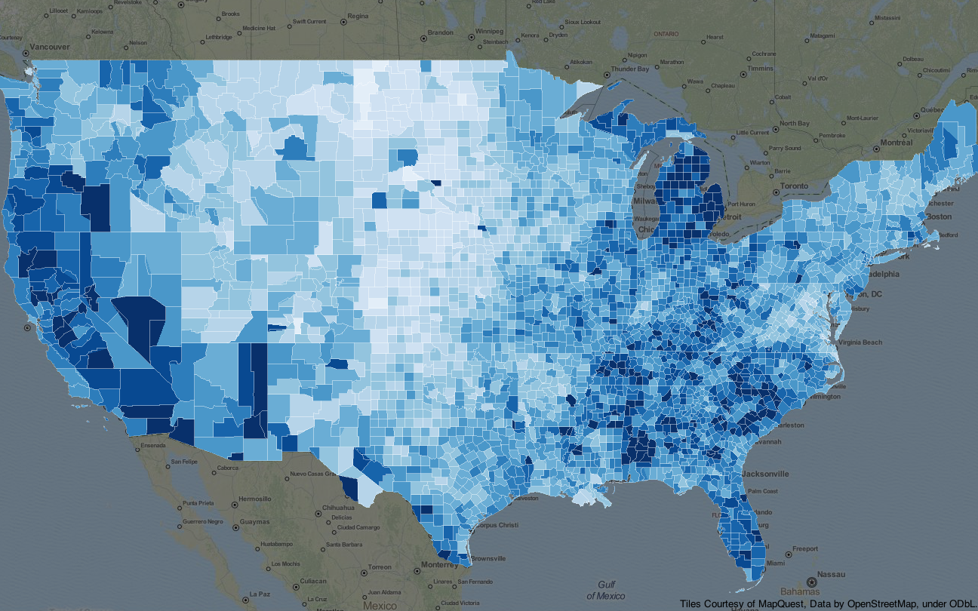
pyglet:
a cross-platform
windowing and multimedia
library
+ Geoplotlib =

Slide 12


Thank you!

